Slide 1




The Lizard Key Game 2.0
By: Aliona D, Nick S, Tyrone M

Slide 2


Summary
Text based video game where player is trapped in a universe of illusion controlled by Mr. Rex.
For the player to get out of Mr. Rex's control the player must survive the dangers of this universe and defeat Mr. Rex.
Only after defeating Mr. Rex the player can have a chance of finding the lizard key which will lead them to their freedom.

Slide 3
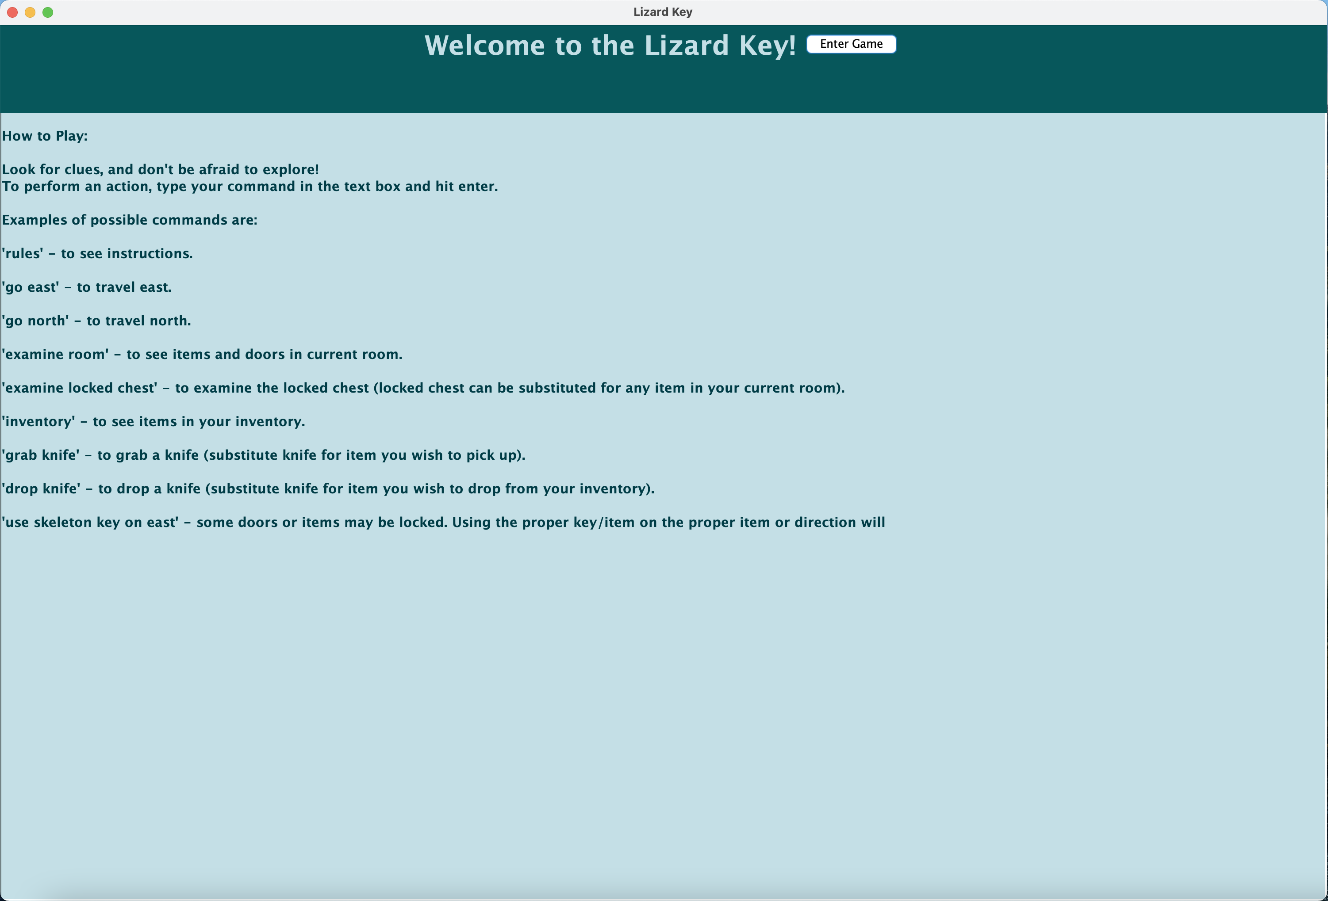
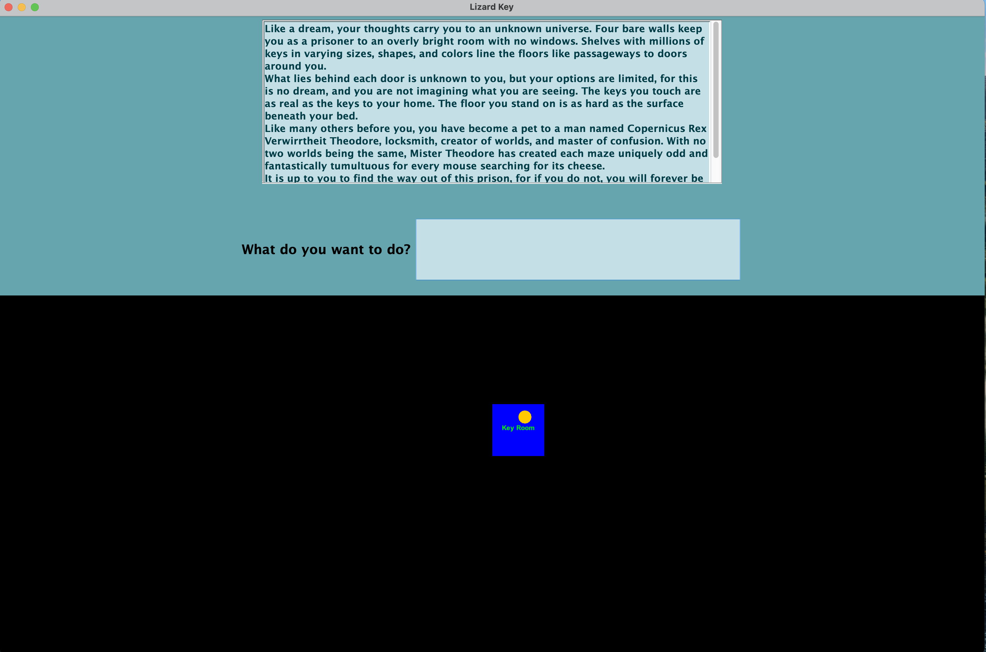
The Lizard Key Original
Intro
Main Game

Slide 4
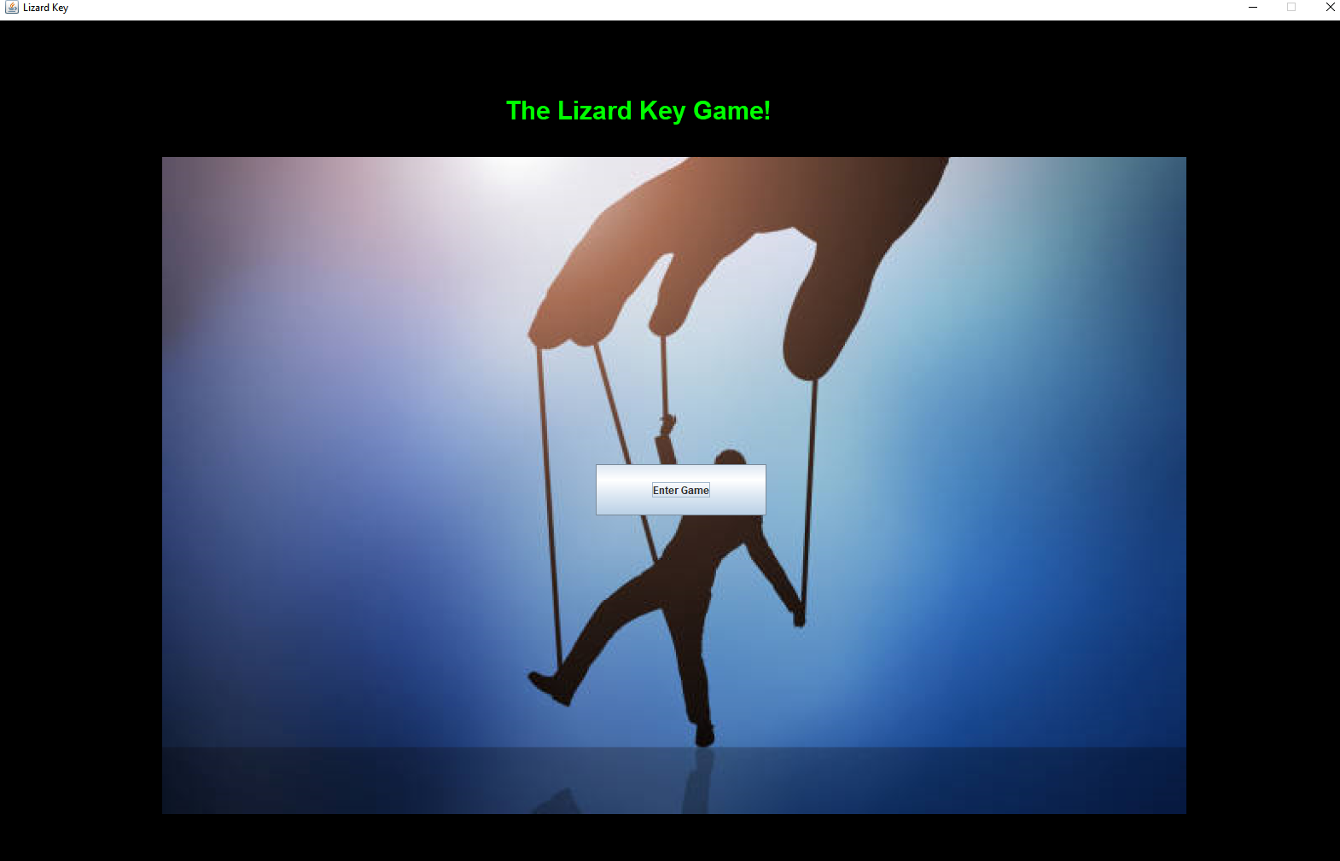
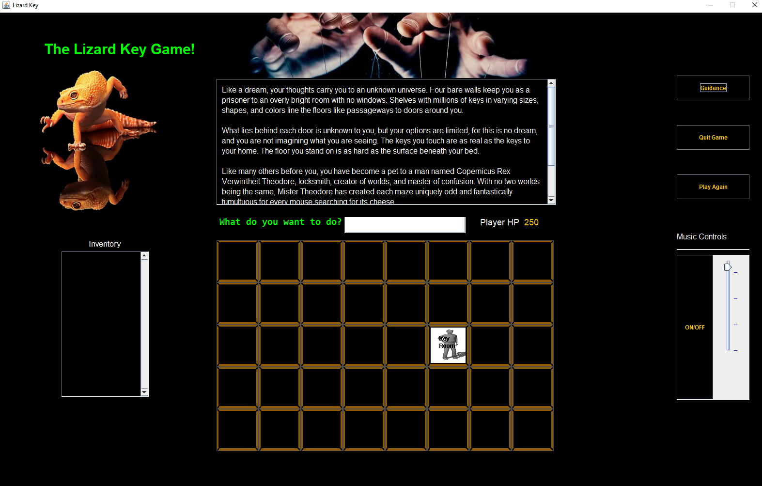
The Lizard Key Revised
Intro
Main Game

Slide 5
Game Highlights
Dynamic "story" that provides the player custom feedback
Improved UI and UX
Numerous "prototypes" created for fast feedback from the customer
Teleportation is a new technique where player can teleport from one room to another instantly.
Playback audio with controls to adjust volume
Revised map navigation experience
Highly contextual map interface
Various buttons and actions
Guidance Button
Quit Game Button
Music Toggle Button
Volume Adjust Slider
Play Again Button

Slide 6
Things we Learned
Decoupled code is easier to change
UI development is its own challenge – some time reading documentation on Swing may have helped
For example, we learned late that colors and components behave differently throughout systems
Model View Controller Design Pattern could have separated our bugs more clearly
Observer design pattern could have improved the text boxes of updating, similar to an adapter
Singleton pattern could have been used for many of these classes, like Player, Game
Design with live deployment in mind – jar builds
Testing and builds are incredibly important toward reducing technical debt​
All types of communication greatly enhance a team's efficiency and workflow
Always document what your code does
Add on to the current technical debt to deliver value quickly. ​
In the Agile process, being specific on what you are working on helps immensely in terms of other team members ​
Learn and utilize the tools to your disposal to reduce technical debt​

Slide 7
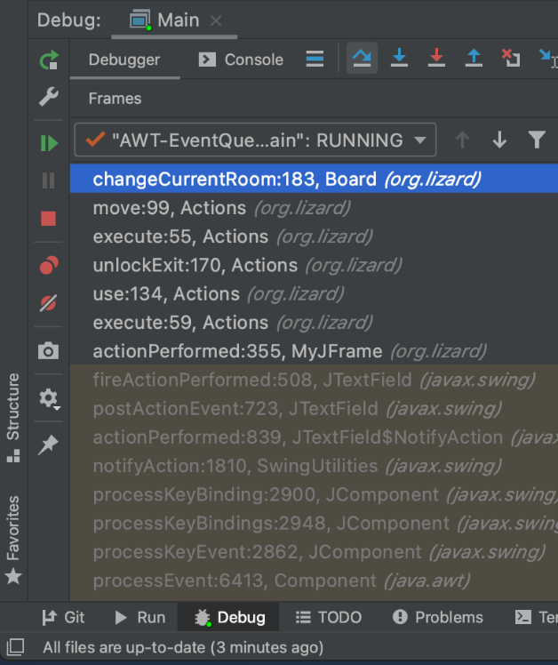
Changes we've faced
Understanding the flow of the game and code​
Separation of concerns and tightly coupled code​
Java variable access modifiers were mostly public making it easy for references to be accessed from other classes and packages, however it increased the difficulty of tracking down bugs to one logical piece of the game​
Lack of unit tests made it difficult to determine if a commit made breaking changes​
Possibly overengineered from the initial design, a more structured Model View Controller pattern and singleton patterns would have greatly enhanced its scalability​
Multiple references of the same objects​
We faced issues regarding type of OS and Java version issues (--enable—preview)​

Slide 8
Future Goals
Refactor the code into distinct classes without any overlap
Favor interfaces over inheritance
Cannot scale very far if the foundation requires some remodeling
Expanding the game play and adding new mechanics that will give the player more chance to strategies

Slide 9
Thank YOu!
Any Questions?

